Slide 1
99* Oddball Techniques for Teaching Marketing: An Alternative to Avoiding Learning
MMA Fall Educators Conference
Friday, Sept. 20, 2024

Slide 2
The Problem: Any of these Gen Z traits sound familiar?
Information Overload
Short Attention Spans
High Expectations for Technology Integration
Need for Practical and Relevant Applications
Soft Skills Development

Slide 3
Information Overload
Gen Z students have grown up in an era of information abundance, which can lead to difficulties in filtering relevant information and focusing on essential concepts amidst the constant barrage of data.
- Liu et al., 2021
Gen Z… members typically experience a higher-than-average level of information overload
- Maier et al., 2015b; Turner, 2015

Slide 4
Short Attention Spans
The pervasive use of social media and digital devices has contributed to shorter attention spans, making it challenging for students to engage in lengthy lectures or traditional teaching methods.
- Poláková and Blanka, 2019
In the classroom, the average student attention span is seven to ten minutes.

Slide 5
High Expectations for Tech. Integration
Having grown up with advanced technology, Gen Z students expect a seamless integration of digital tools and resources in their learning experiences. Inadequate or outdated technology in the classroom can be a significant frustration.
- Poláková and Blanka, 2019

Slide 6
Need for Practical and Relevant Applications
This generation values practical, real-world applications of theoretical knowledge. They may find it challenging to stay motivated in courses that do not clearly connect academic concepts to real-world marketing practices.
- Seemiller and Clayton, 2019

Slide 7
Soft Skills Development
Despite their digital proficiency, Gen Z students may struggle with developing soft skills such as interpersonal communication, teamwork, and critical thinking, which are essential in the marketing field.
- Kouakou, 2023
Gen Z employees often have difficulty communicating effectively, especially when asking for help, and face challenges in forging positive collaborations with colleagues
- Castro, 2023

Slide 8
Some Solutions: Oddball/Creative/Outside the Box Techniques
Information Overload
Assignment: Impossible!
Give assignment that can’t be completed with information given. Forces students to struggle, and decide what info. is REALLY relevant.

Slide 9
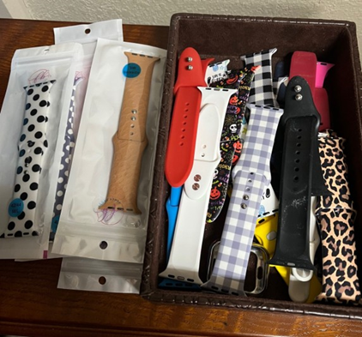
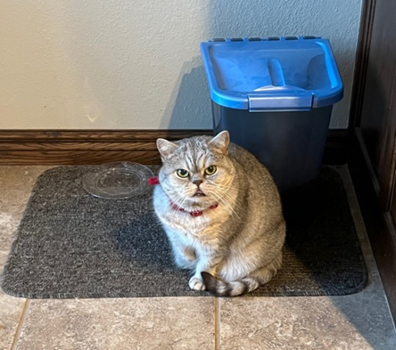
Some Solutions: Oddball/Creative/Outside the Box Techniques
Short Attention Spans
What Happens in Class…..
Show personal pics/examples that reinforce a marketing concept.
Wife, Son, Pets, etc.
FUN: Don’t tell my wife!

Slide 10
Some Solutions: Oddball/Creative/Outside the Box Techniques
High Expectations for Technology Integration
Encourage Tech. Usage in Class
- Ask students to look up info.
- Challenge them to check my facts

Slide 11
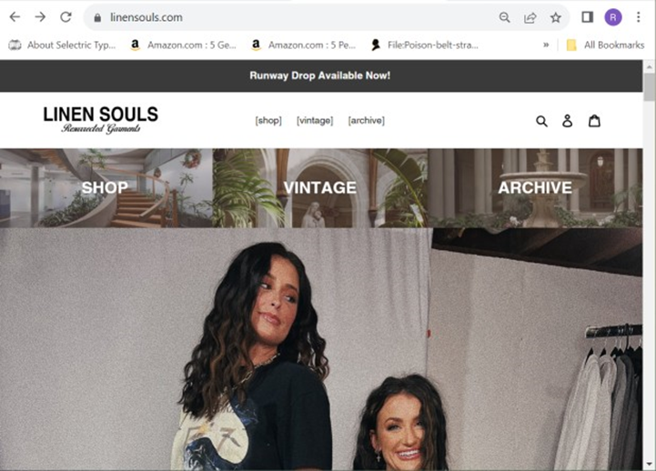
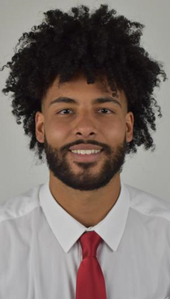
Some Solutions: Oddball/Creative/Outside the Box Techniques
Need for Practical and Relevant Applications
Student Business Example
Highlight a student’s business/side hustle/web site.
Ask student to talk about real challenges, goals
It’s REAL and RELEVANT

Slide 12
Some Solutions: Oddball/Creative/Outside the Box Techniques
Soft Skills Development
Require Short Student Presentations
(about topics of interest to them)
Letting them pick their own topics lowers the anxiety level, and creates real, personal and profess. collaboration between students

Slide 13
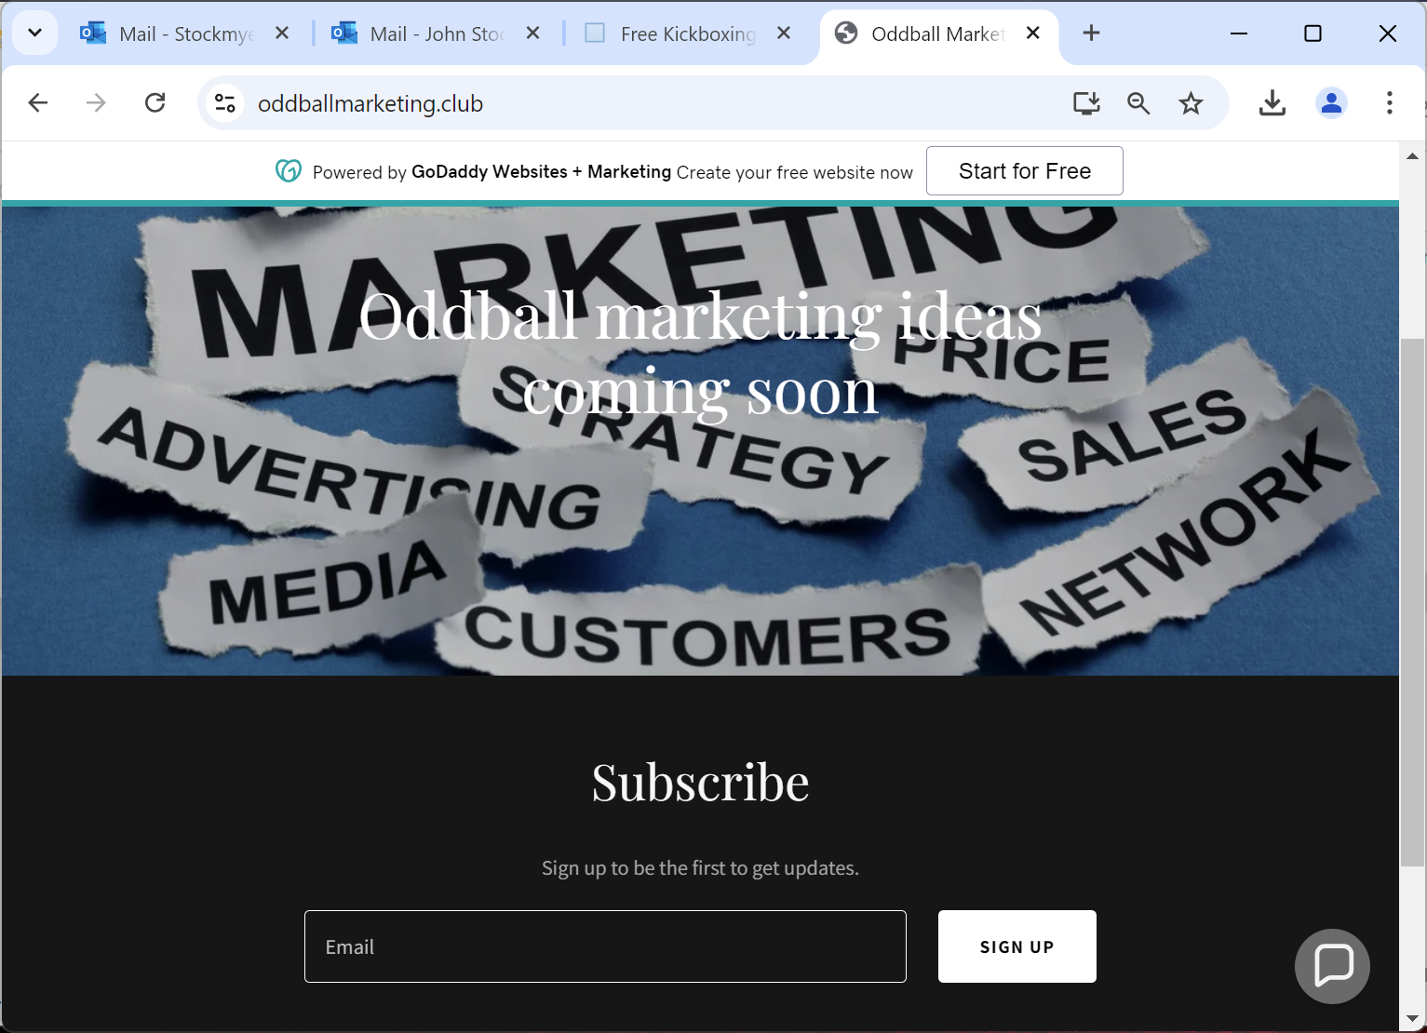
Next Steps:
What do YOU think?
Create a repository of techniques
Join the Club!
www.oddballmarketing.club

Slide 14
Thank You For Your Attention! Contact:
Dave Aron – Dominican University
E-mail: daron@dom.edu
John Stockmyer – Northwestern Oklahoma State University
E-mail: jlstockmyer@nwosu.edu

